Slide 1
Simple Pipeline

Slide 2
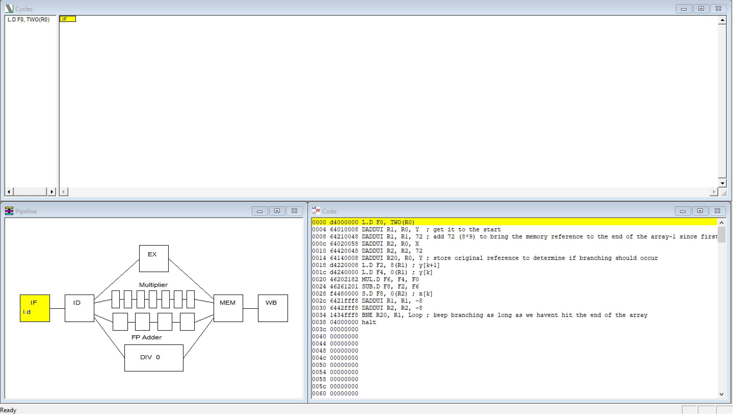
Instruction Fetch

Slide 3
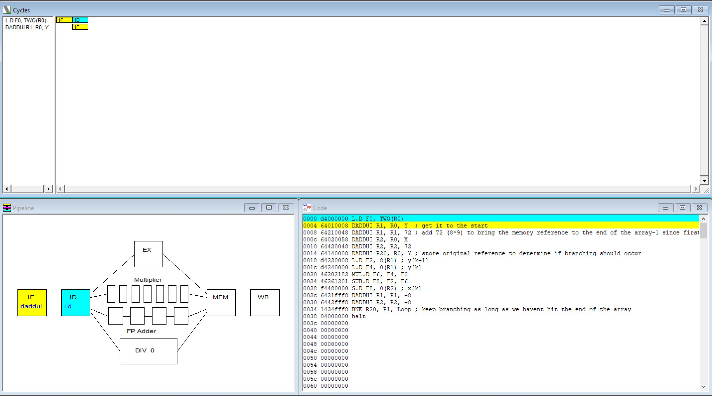
Instruction Decode

Slide 4
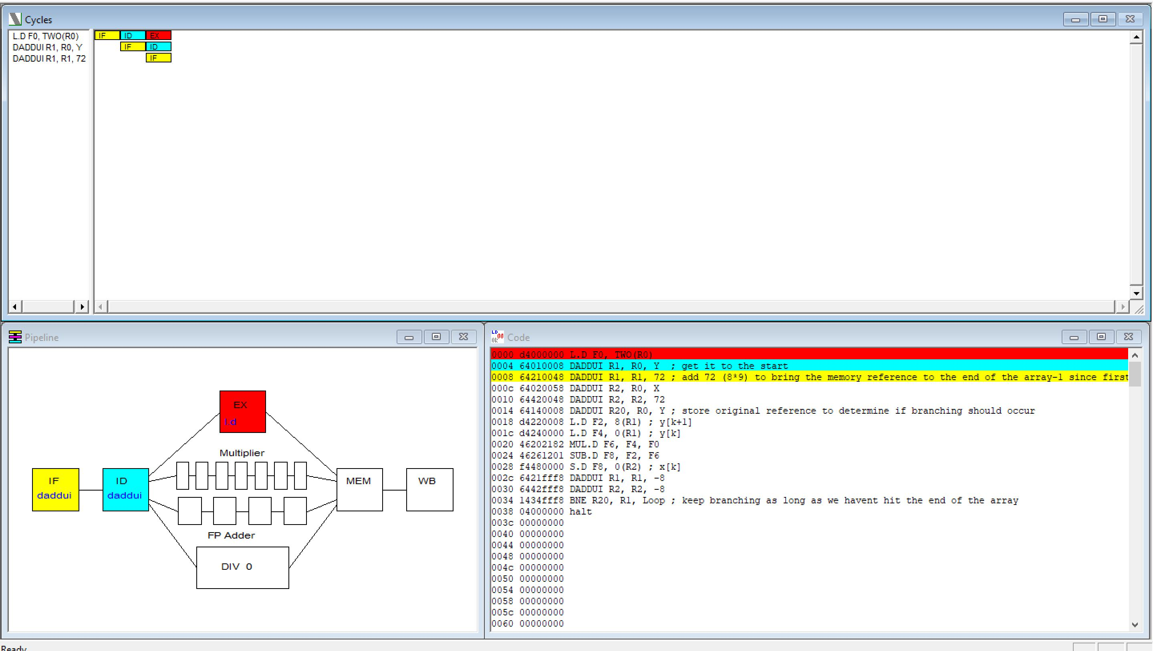
Instruction Execute

Slide 5
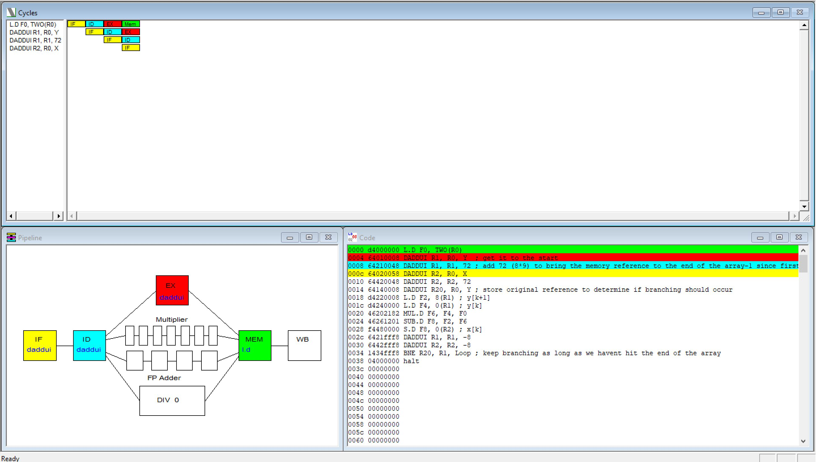
Mem access

Slide 6
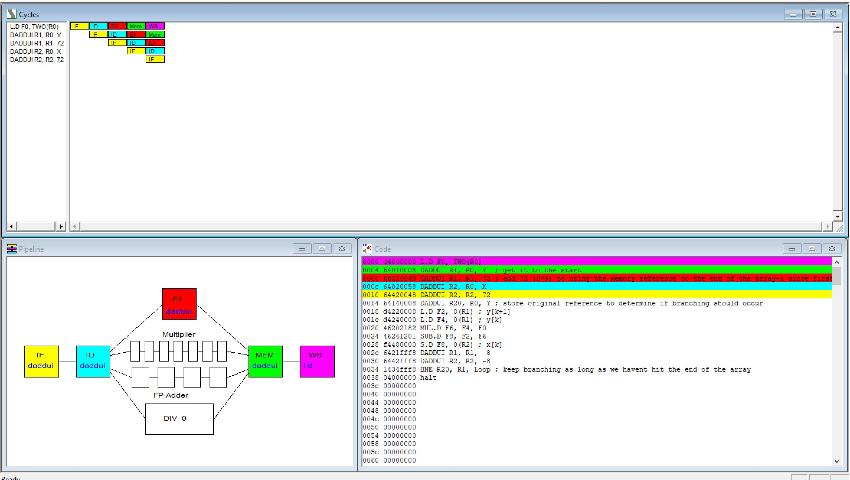
Write Back

Slide 7
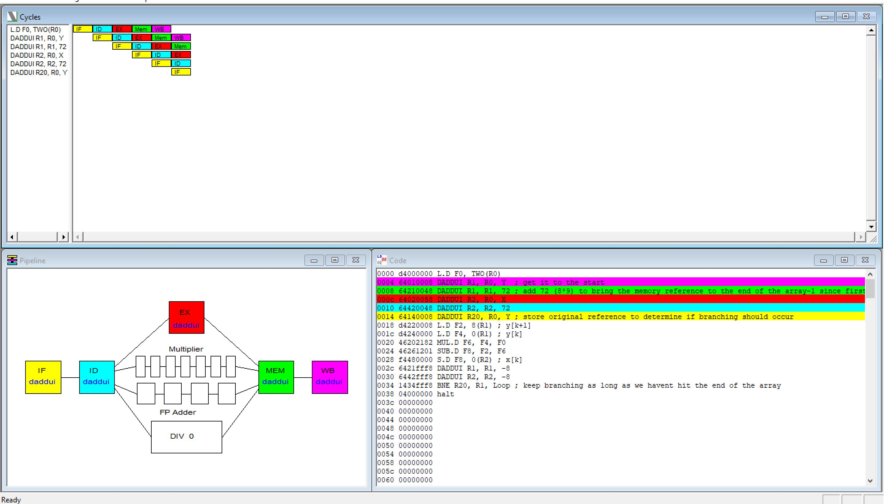
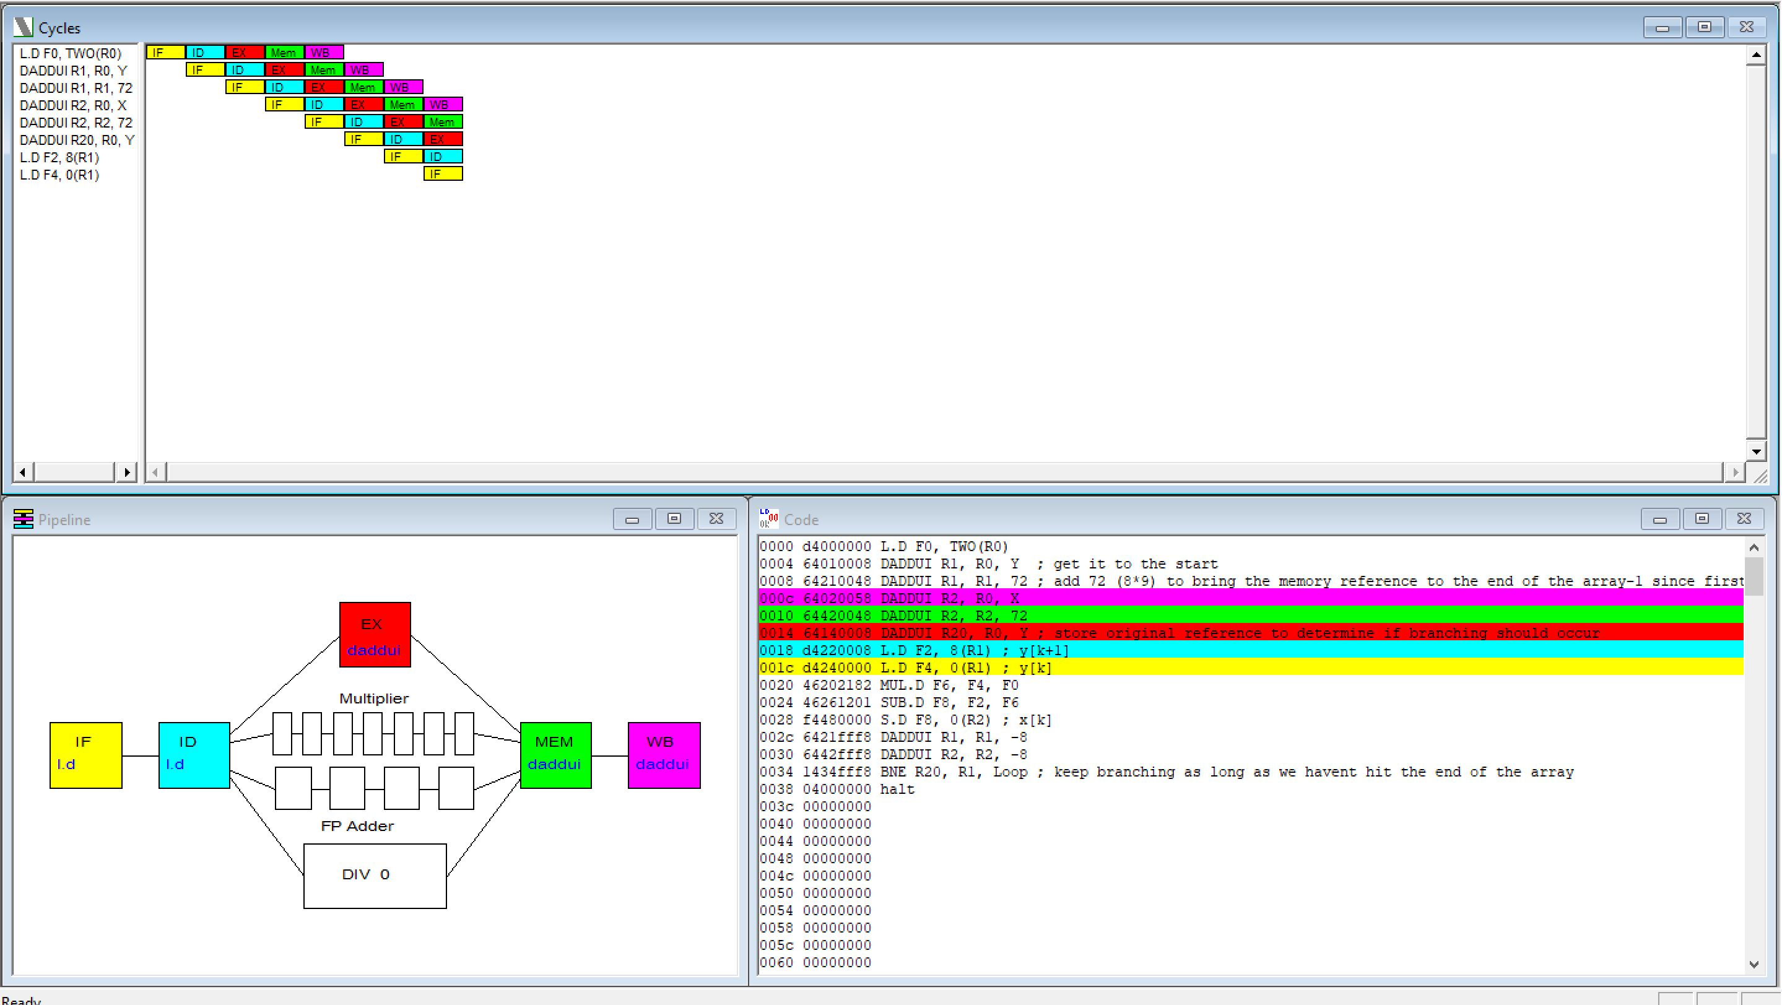
Full Pipeline

Slide 8
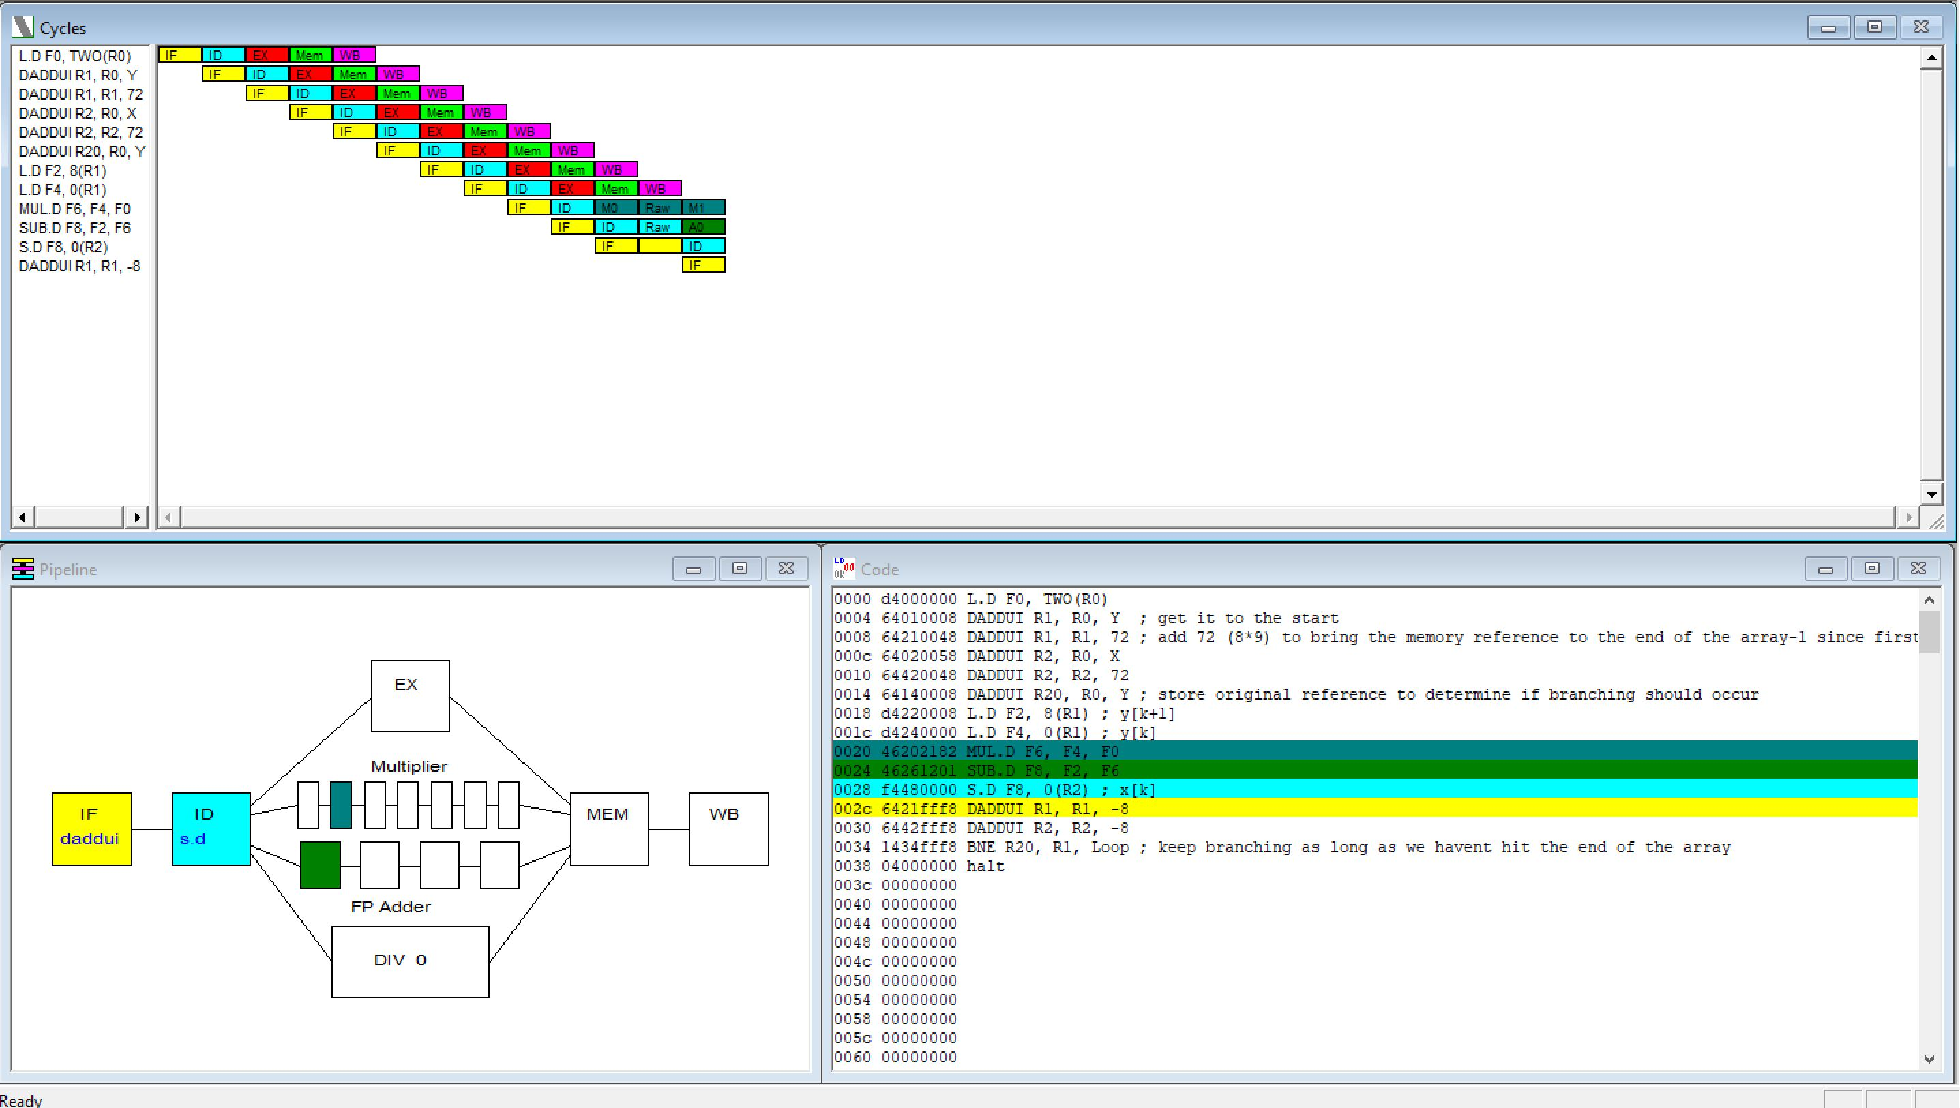
Multiplication/Subtraction taking more cycles then other ops

Slide 9
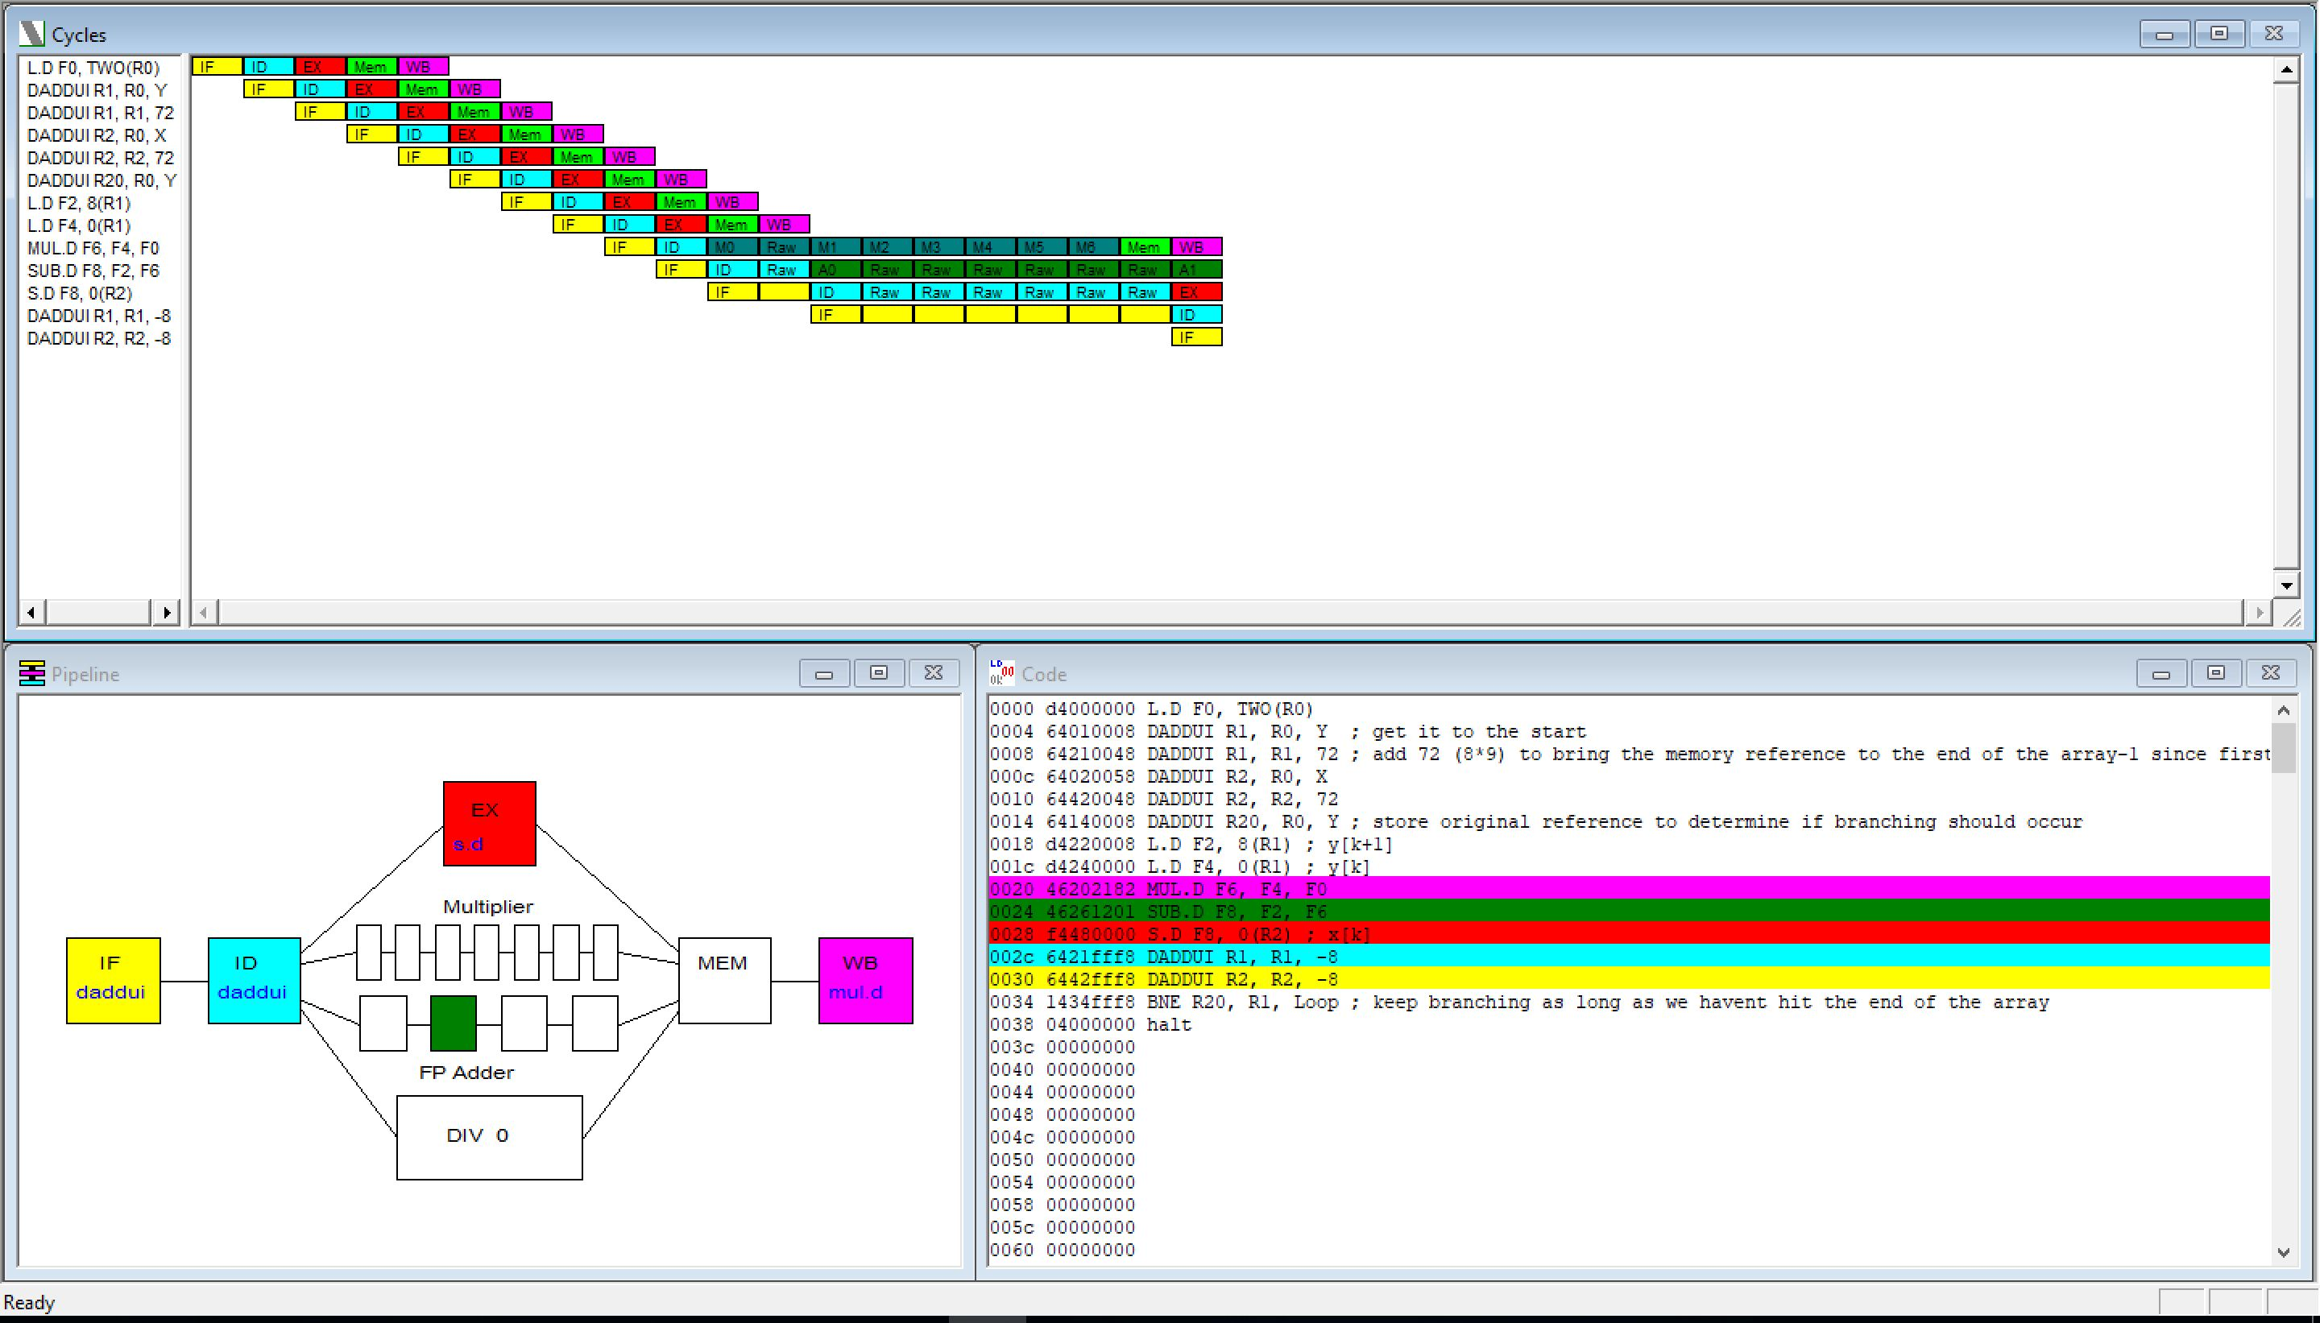
Impact of multiplication/subtraction on pipeline

Slide 10
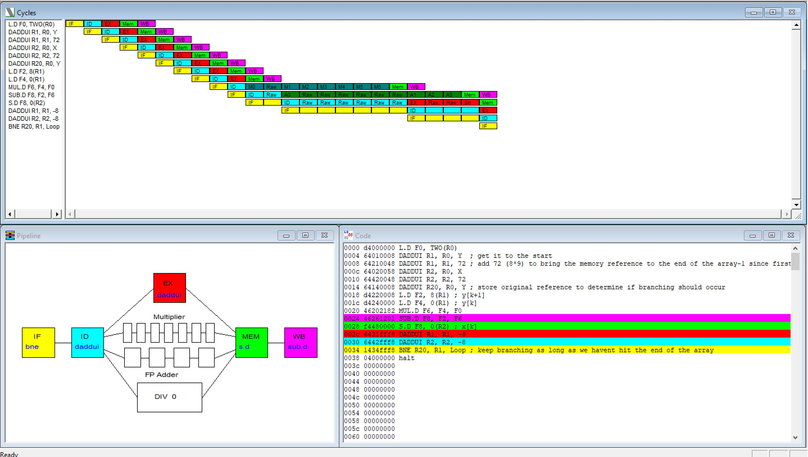
Branch Fetch

Slide 11
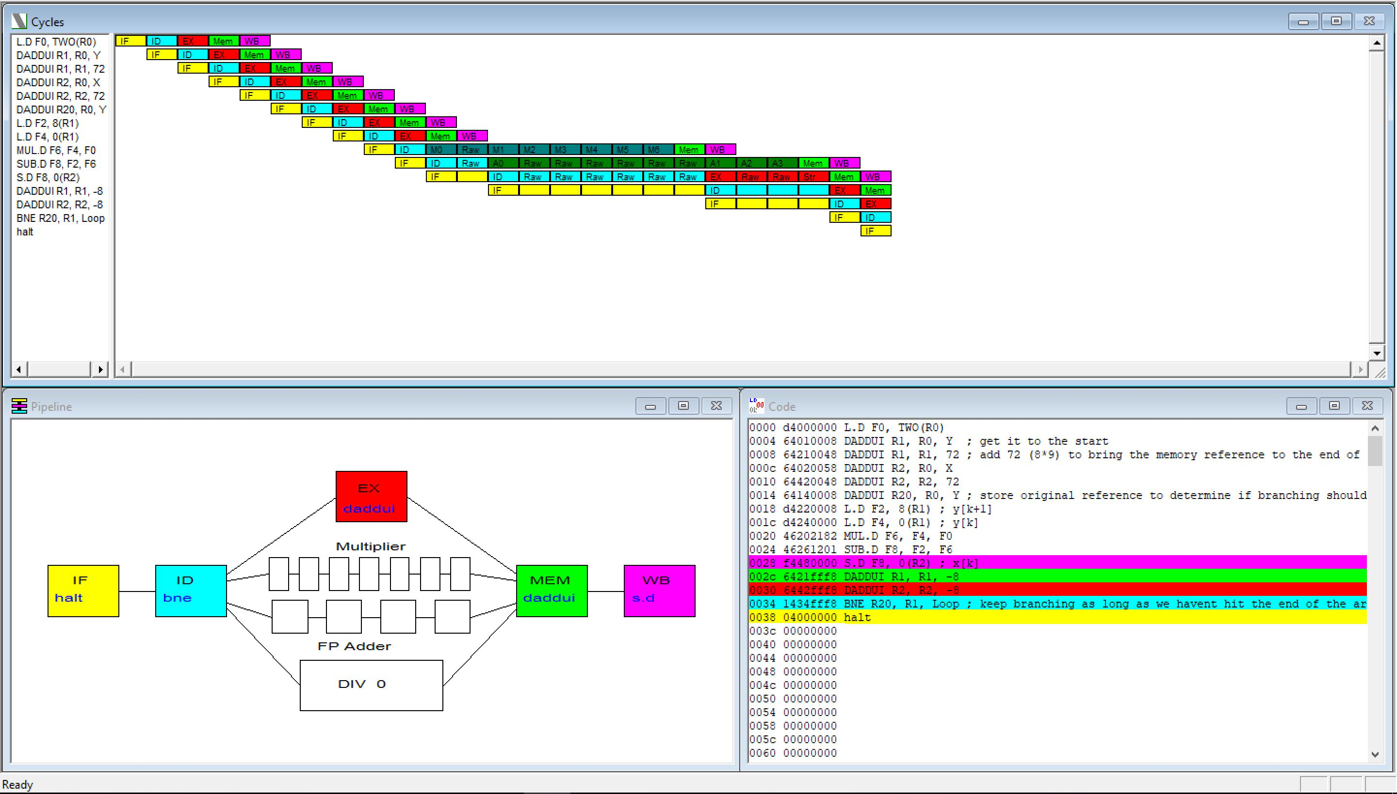
Branch Predicted as not taken

Slide 12
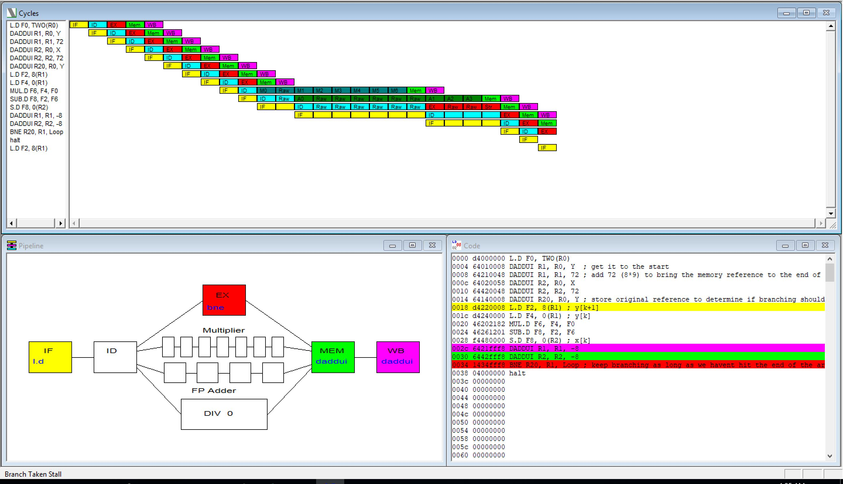
Prediction is wrong hence op needs to be flushed

Slide 13
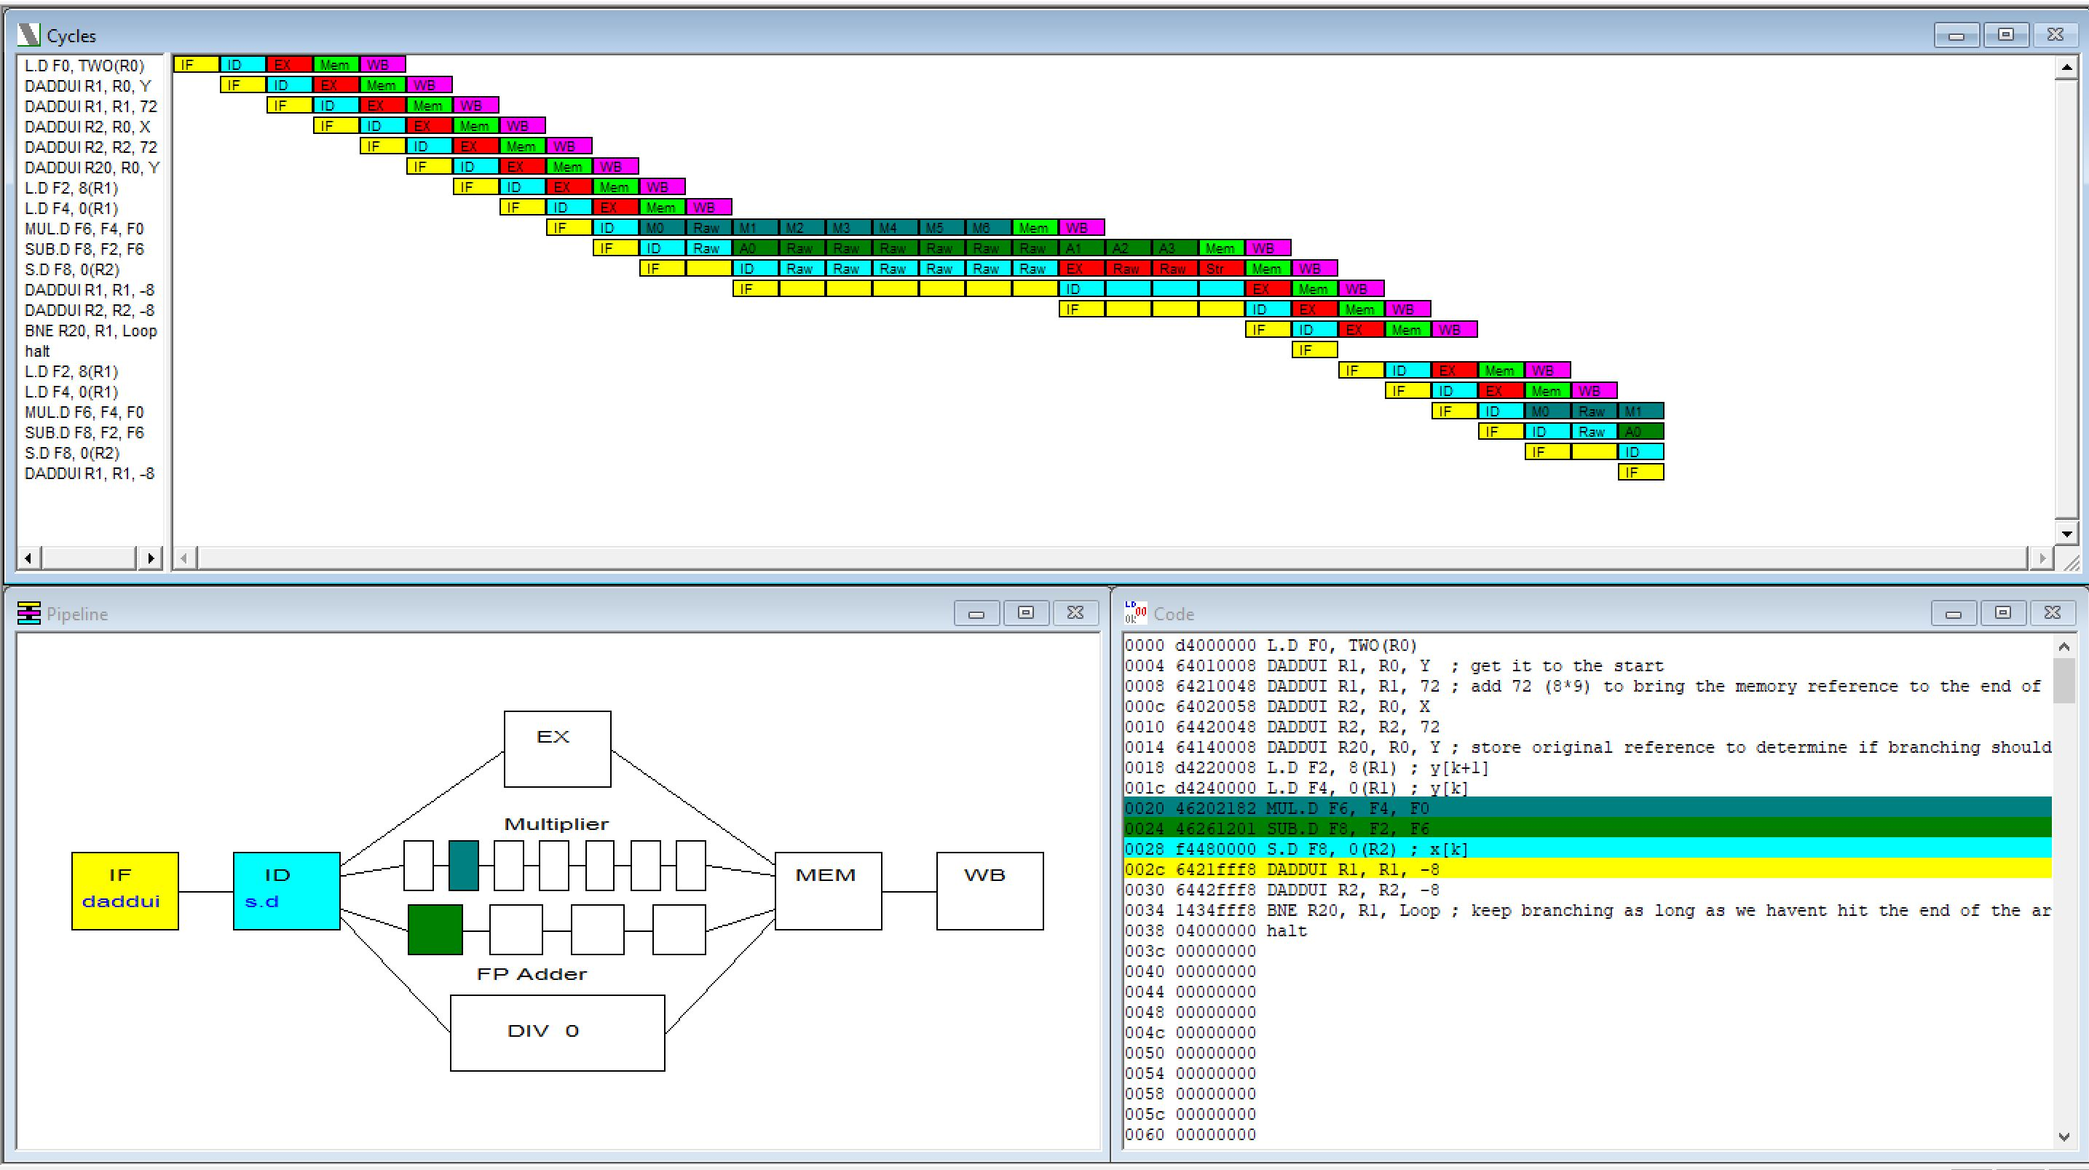
Impact of miss prediction

Slide 14
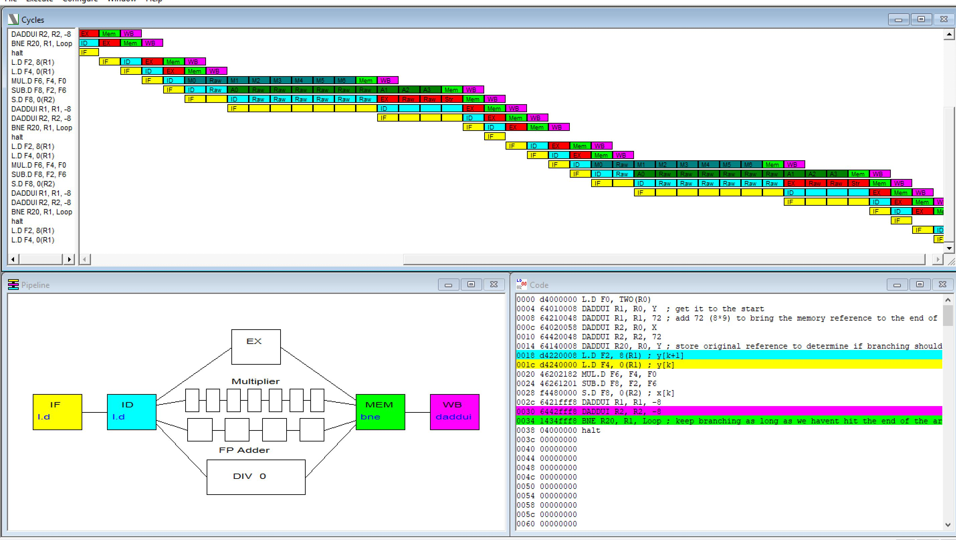
WinMips64 always predicting branch not taken

